Slide 1
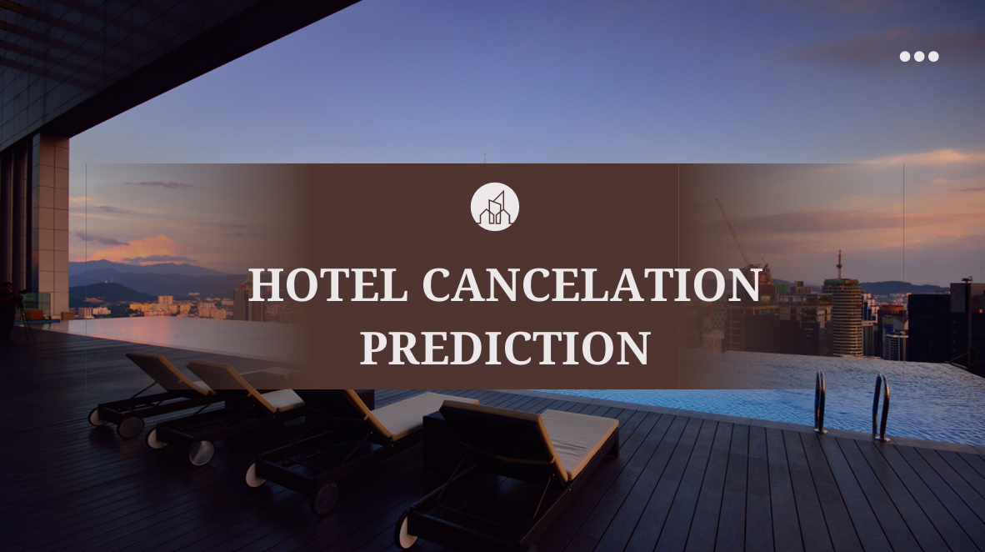
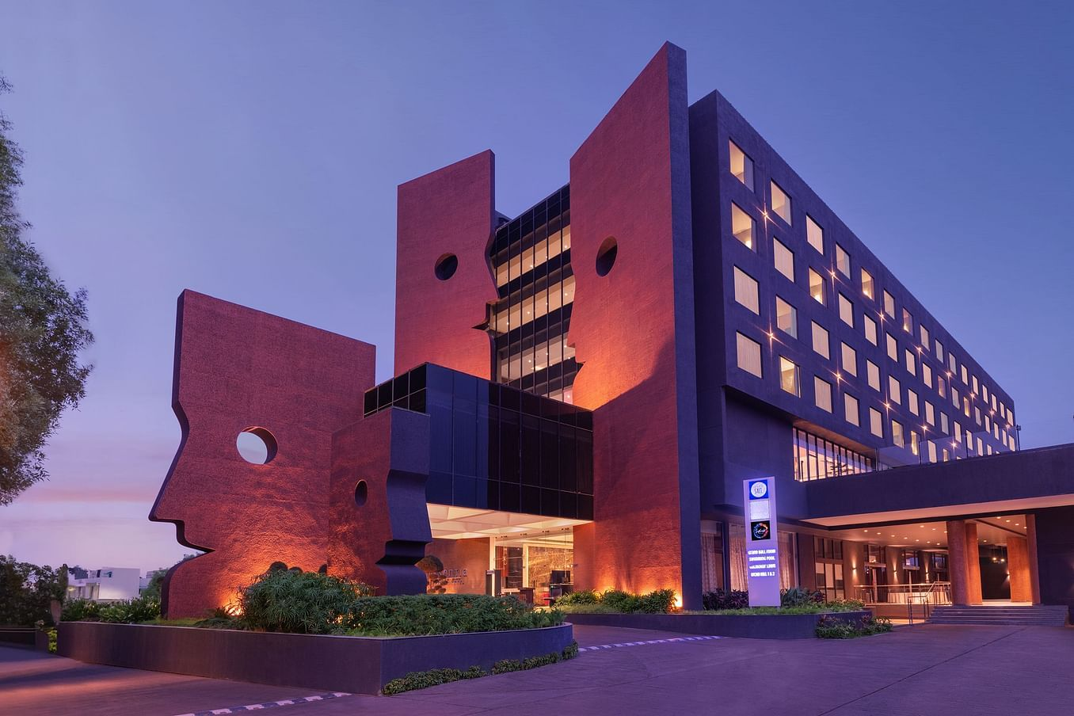
HOTEL CANCELATION PREDICTION

Slide 2

Problem Statement
❓ What are we trying to solve
Hotels lose revenue due to last-minute booking cancellations.
Can we predict if a booking will be canceled based on the data provided at the time of reservation?

Slide 3

Dataset Overview
📊 Where does the data come from and what does it contain ?
Dataset: Hotel Booking Dataset (36,285 rows × 17 features)
Contains information like:
Number of guests
Stay duration
Meal plan
Lead time
Room type
Special requests
Booking status (target)

Slide 4

Exploratory Data Analysis (EDA)

Slide 5
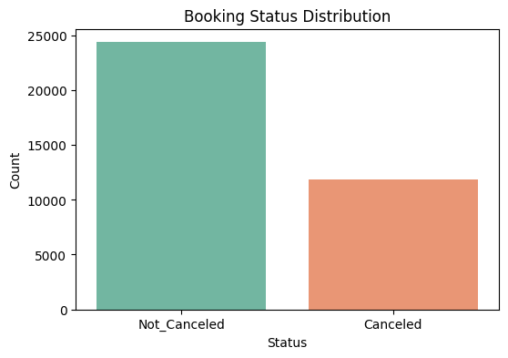
Booking Status Distribution
“We started by analyzing the overall status of the bookings. A noticeable portion of the reservations were canceled, while the majority were completed. This led us to the key question: Can we predict in advance whether a booking will be canceled ?

Slide 6
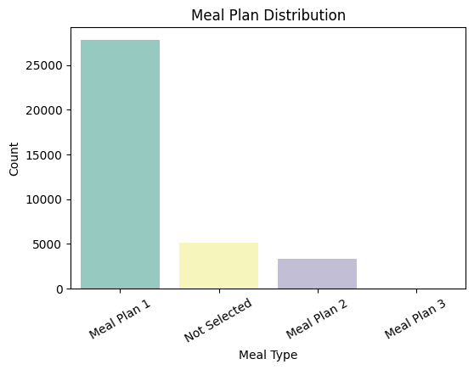
Meal Plan Distribution and Impact
We then looked into the type of meal plans selected by guests. Most bookings included Meal Plan 1, while others chose either no meal plan or different packages.
Although this feature doesn’t directly cause cancellation, understanding meal preferences can help hotels offer better-targeted services. Later, we’ll analyze if certain meal plans are more associated with canceled bookings.

Slide 7
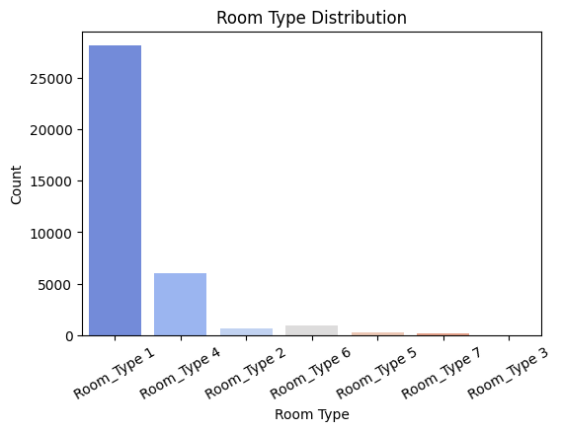
Room Type Distribution and Trends
Next, we explored the types of rooms that were booked. The majority of guests chose Room Type 1, which is likely the standard or most affordable option.
Other room types were selected less frequently, which may indicate they are premium options or less popular.

Slide 8
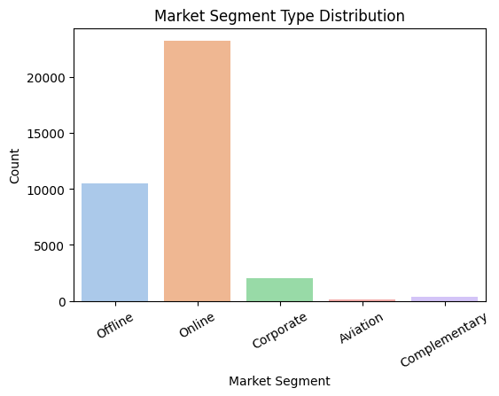
Market Segment Analysis
We also analyzed how guests are reaching the hotel — this is captured by the market segment type feature.
Most bookings came through a few main channels, such as online platforms or corporate sources, while others used offline or direct methods.
Later, we’ll explore whether certain market segments are more prone to cancellations, which could help hotels focus on more reliable channels.

Slide 9
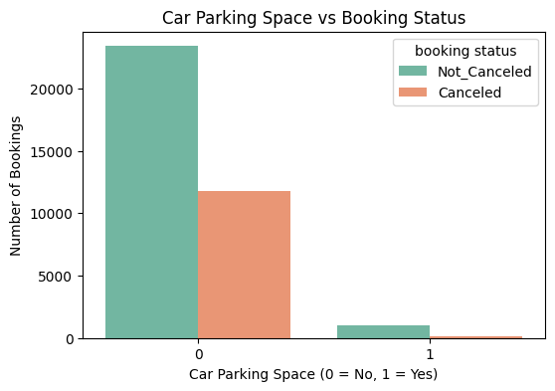
Car Parking Space vs Booking Status
“In this analysis, we examined whether reserving a car parking space is associated with booking cancellations.
We found that guests who reserved parking were generally less likely to cancel their bookings.
This behavior may indicate stronger commitment or better-defined travel plans among guests who arrive by car.
Therefore, the car parking feature could be a useful predictor in identifying reliable customers.”

Slide 10
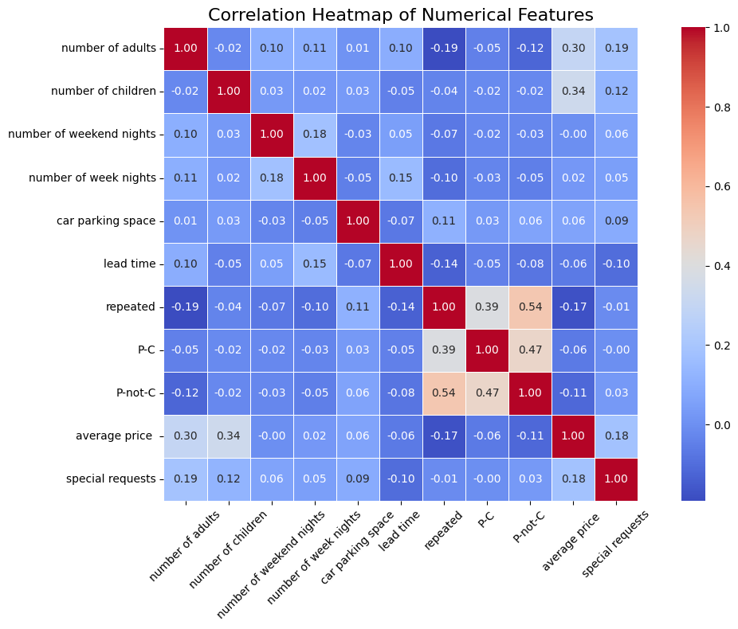
Correlation Heatmap of Numerical Features
This heatmap visualizes the correlation between numerical features in the dataset. The color scale shows the strength of correlation — red indicates a strong positive correlation, while blue indicates a weak or negative correlation.

Slide 11

Thank You

